Slide 1
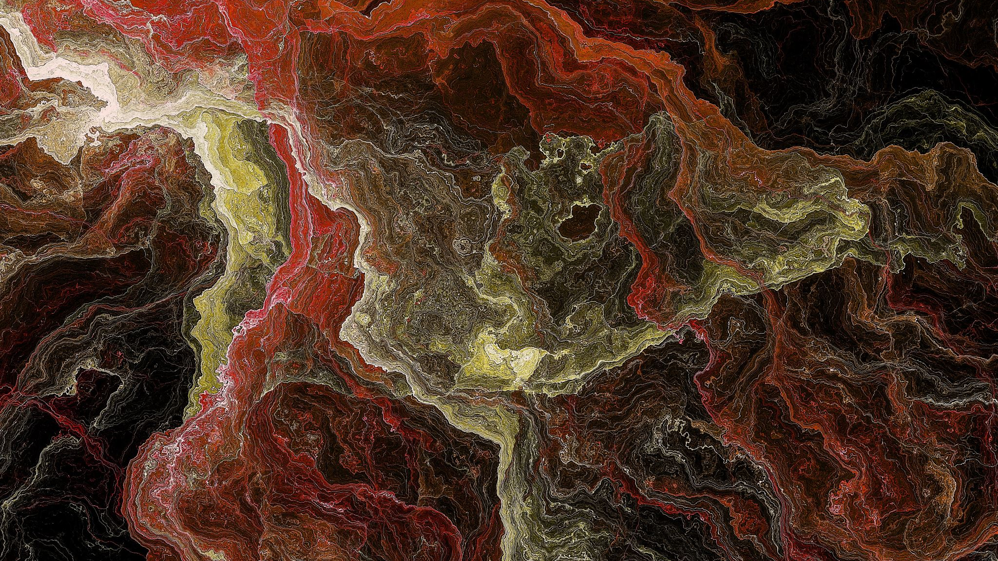
YOLOv4: Optimal Speed and Accuracy of Object Detection
Presented by.
Jehad Said
Lamiaa Omar
Mahmoud Mostafa Tayee

Slide 2
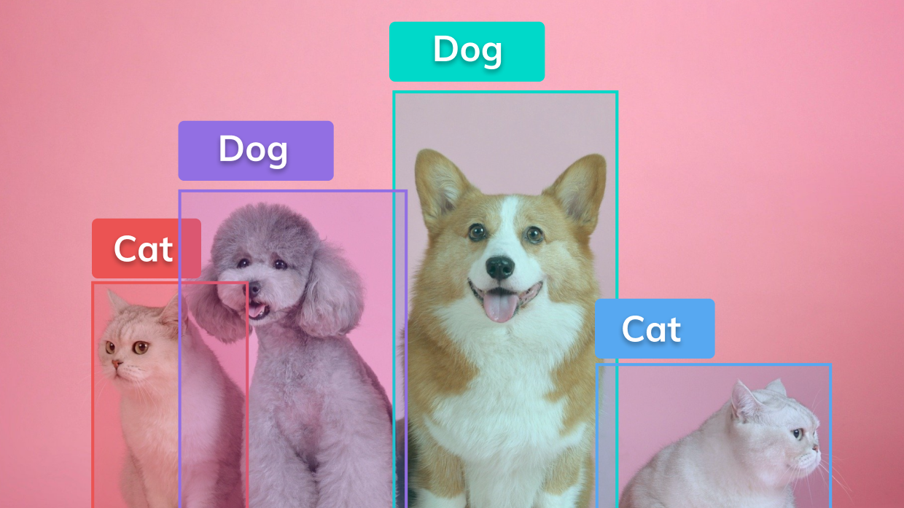
Object detection

Slide 3
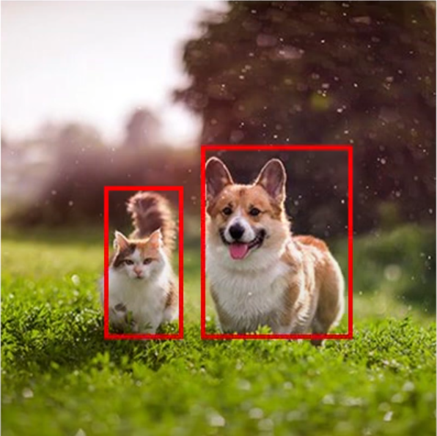
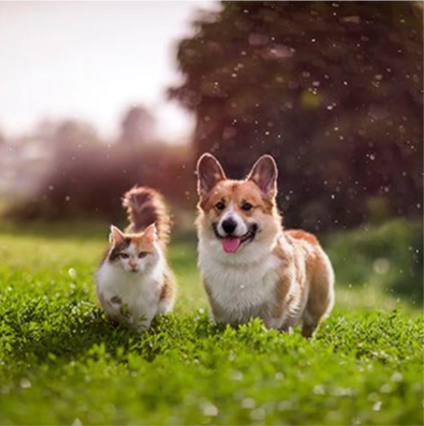
Overview(Cont’d)
Dog
Cat

Slide 4

Overview
Object detection
One-stage object detection
Two-stage object detection

Slide 5
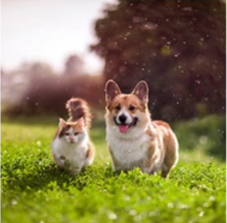
Overview(Cont’d) 1-stage object detection
Dog
Stage 1
Cat

Slide 6
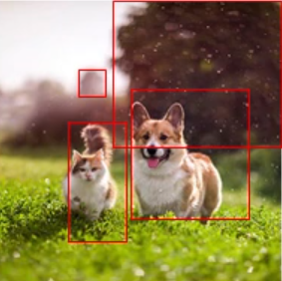
Overview(Cont’d) 2-stage object detection
Dog
Stage 1
Stage 2
Cat

Slide 7
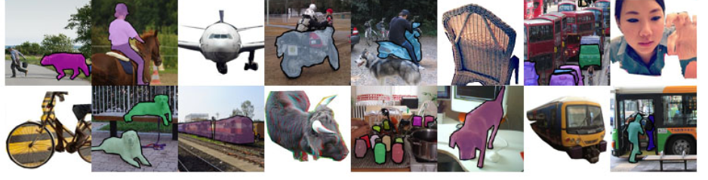
Dataset
COCO(Microsoft):
330K images (>200K labeled).
1.5 million object instances.
80 object categories.

Slide 8
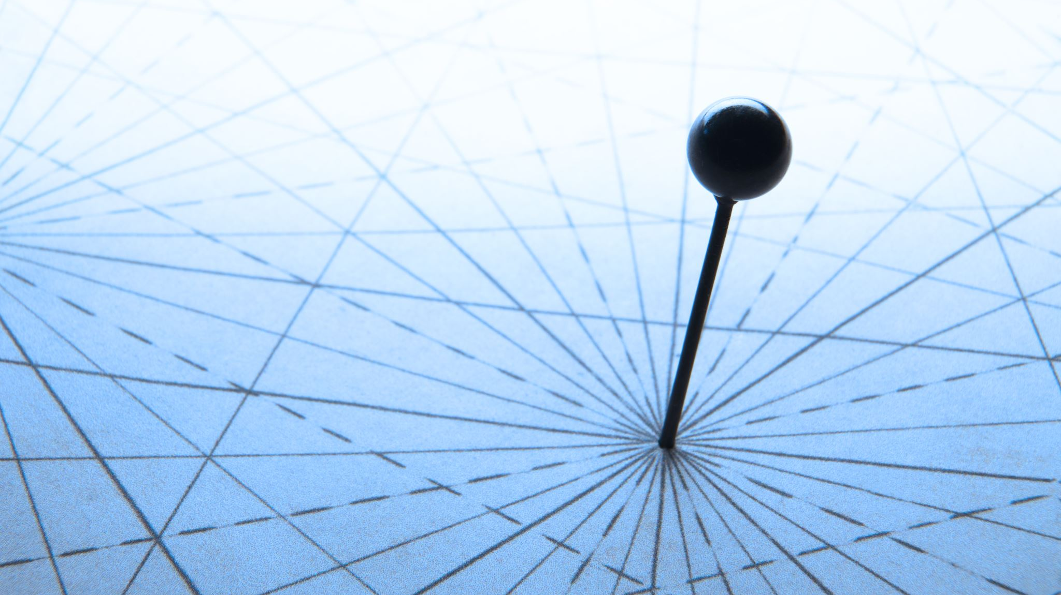
Related work
1- Object detection models

Slide 9

Two-stage object detection

Slide 10
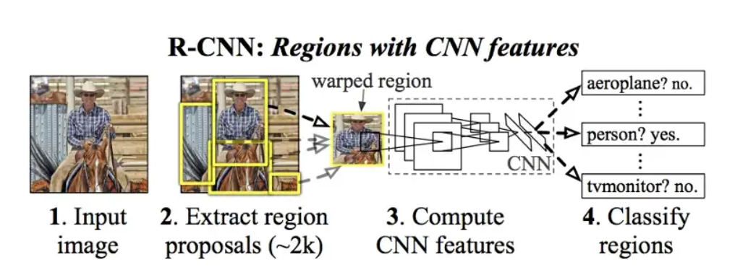
1- Object detection models R-CNN(2-stage)
Stage 1
Stage 2

Slide 11
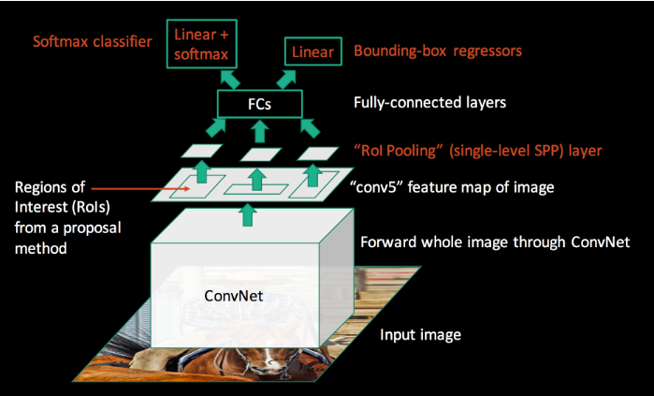
1- Object detection models Fast R-CNN(2-stage)
Stage 2
Stage 1

Slide 12
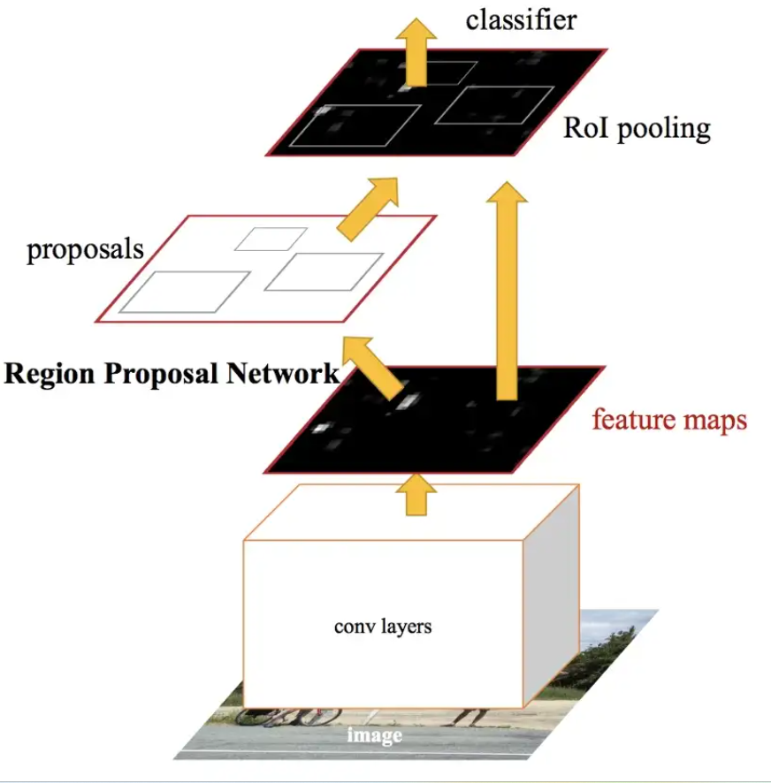
1- Object detection models Faster R-CNN(2-stage)
Stage 2
Stage 1

Slide 13
One-stage object detection

Slide 14

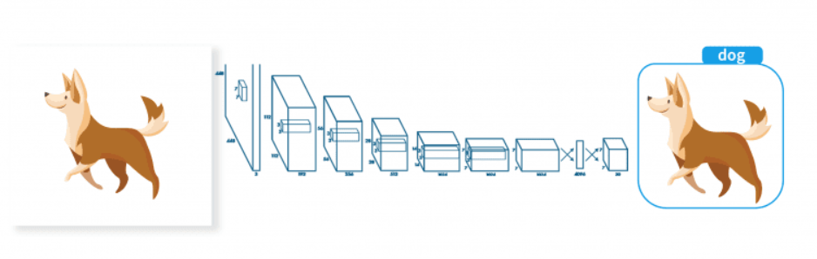
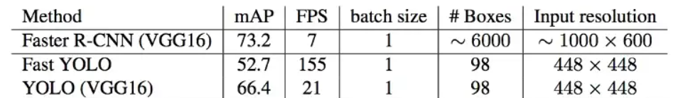
1- Object detection models YOLO(1-stage)
Optimal Speed and Accuracy of Object Detection

Slide 15
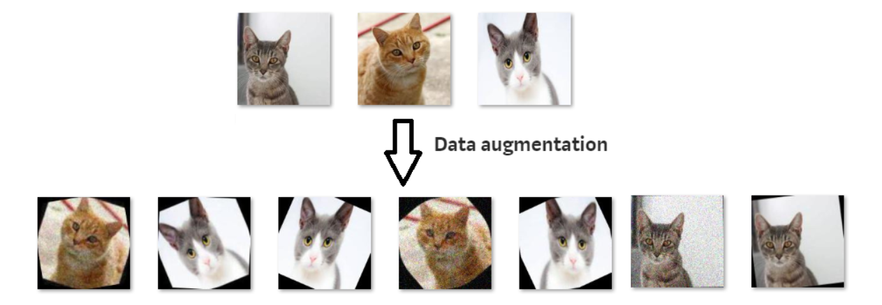
2- Bag of freebies
Improvement in the overall accuracy without increasing the overall inference cost.

Slide 16
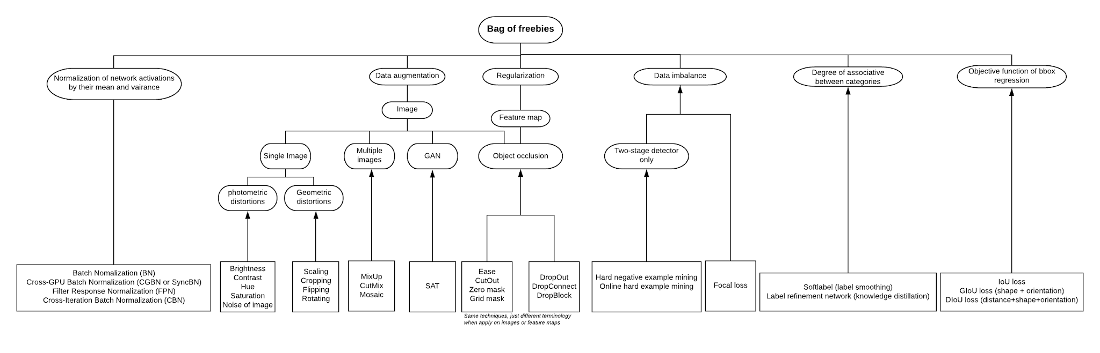
2- Bag of freebies

Slide 17
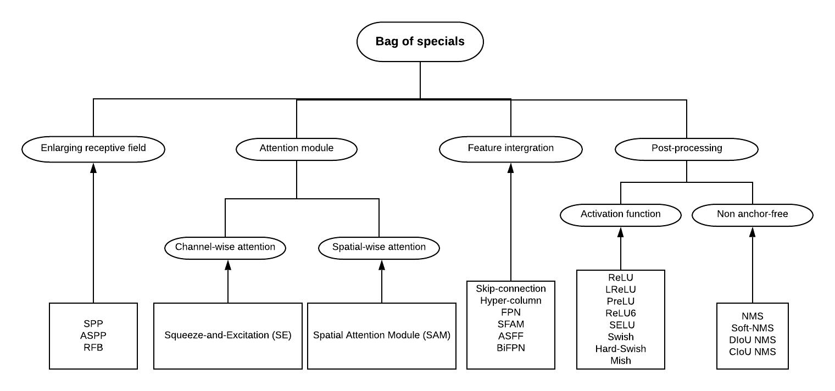
3- Bag of specials
post-processing methods, only increase the inference cost by a small amount, but can significantly improve the accuracy.

Slide 18

Methodology

Slide 19
The anatomy of object detection
Backbone
(Feature extraction)
Head
(Detection)
Neck
(collect feature maps from different stages)

Slide 20
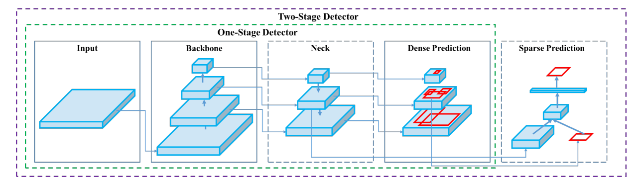
The anatomy of object detection

Slide 21
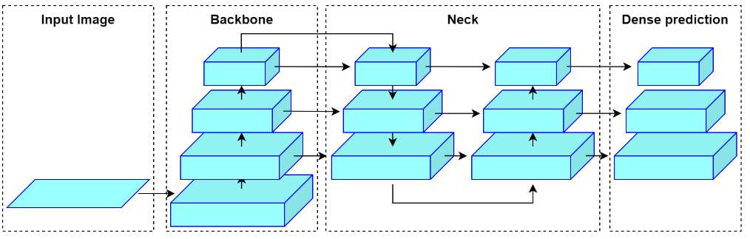
YOLO architecture

Slide 22
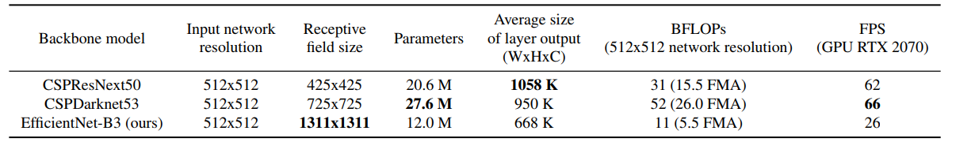
Methodology: Selection of architecture Backbone
Darknet?
Open-source neural network framework.
Fast and highly accurate.
Framework for real time object detection because it is written in C and CUDA.

Slide 23
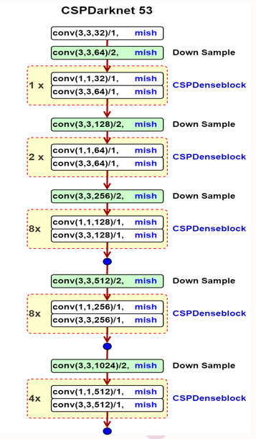
Methodology: Selection of architecture Backbone
Continuously differentiable activation function.
The next objective is to select additional blocks for increasing the receptive field and the best method of parameter aggregation from different backbone levels for different detector levels.

Slide 24
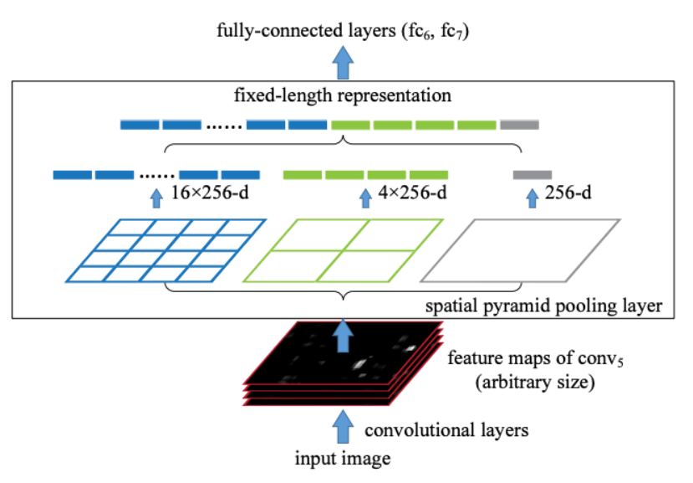
Methodology: Selection of architecture Neck-Spatial pyramid pooling(SPP)
significantly increases the receptive field.
separates out the most significant context features.
pooling layer that removes the fixed-size constraint of the network.
The SPP layer pools the features and generates fixed-length outputs.
BOS

Slide 25
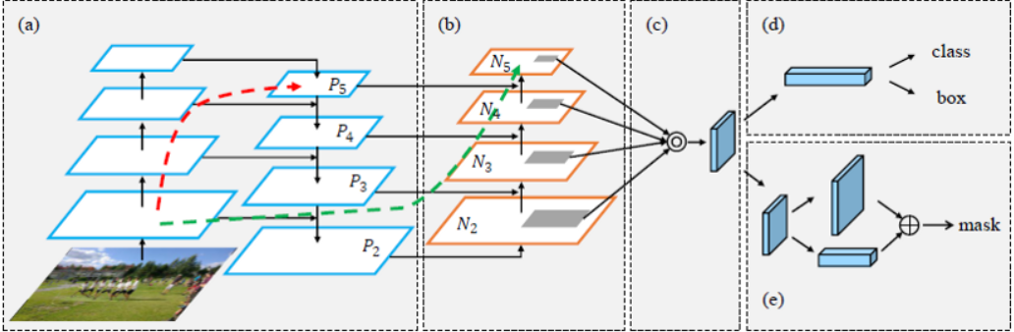
Methodology: Selection of architecture Neck-Path aggregation network(PAN)
Way to improve the work of FPN.
Using the lateral connections with the element wise additions to add in the information from the low-level layers.
The low-level features information helps with localization information which can help in localization of objects.
BOS

Slide 26
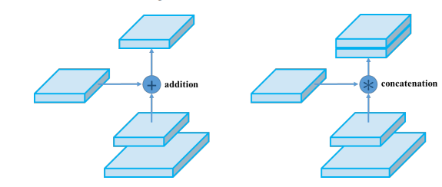
Methodology: Selection of architecture Neck-Path aggregation network(PAN)
Modified PAN:
Instead of using element wise addition, they used concatenation.
BOS

Slide 27
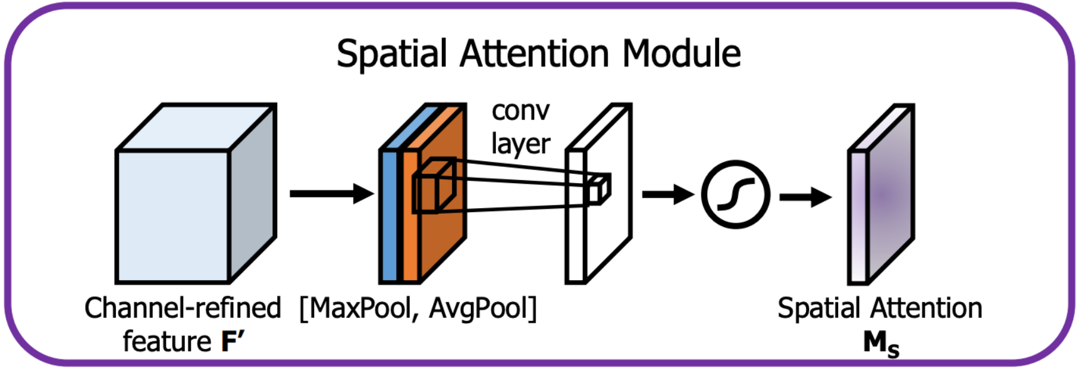
Methodology: Selection of architecture Neck-Spatial attention module(SAM)
Is a module for spatial attention in convolutional neural networks.
Generates a spatial attention map by utilizing the inter-spatial relationship of features.
To compute the spatial attention:
we first apply average-pooling and max-pooling operations along the channel axis and
Concatenate them to generate an efficient feature descriptor.
On the concatenated feature descriptor, we apply a convolution layer to generate a spatial attention map which encodes where to emphasize or suppress.
BOS

Slide 28
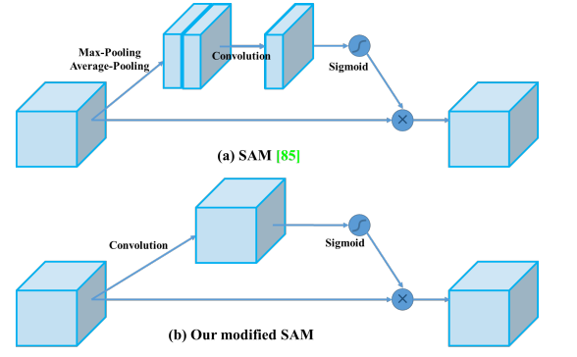
Methodology: Selection of architecture Neck-Spatial attention module(SAM)
Modify SAM from spatial-wise attention to pointwise attention.
BOS

Slide 29
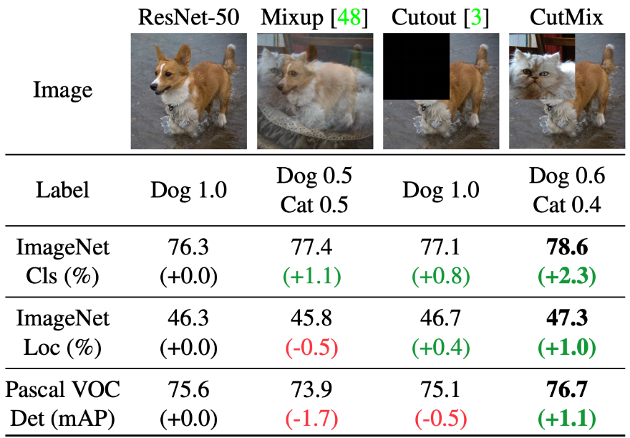
Methodology: Selection of architecture Bag Of Freebies-CutMix
Instead of simply removing pixels as in CutOut, we replace the removed regions with a patch from another image.
The ground truth labels are also mixed proportionally to the number of pixels of combined images.
The added patches further enhance localization ability by requiring the model to identify the object from a partial view.

Slide 30
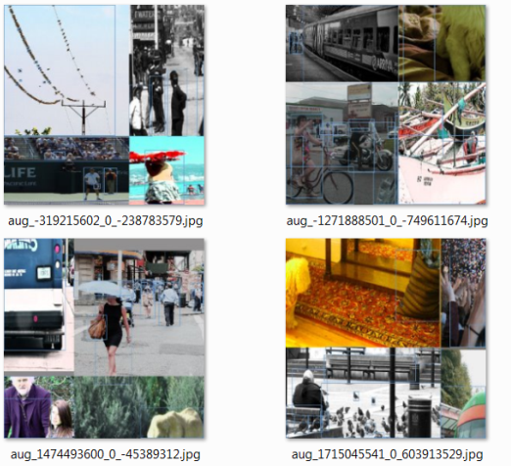
Methodology: Selection of architecture Bag Of Freebies-Mosaic
Take 4 images and combine them into a single image.
Resizing each of the four images, stitching them together, and then taking a random cutout of the stitched images to get the final Mosaic image.
Allow detection of objects out their normal context.
Reduce need for large mini-batch size.

Slide 31
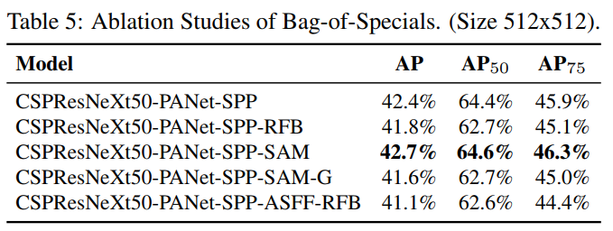
Experiments and Results.

Slide 32
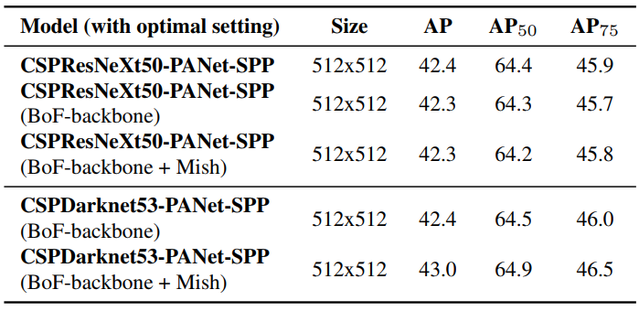
Experiments and Results.
The CSPDarknet53 outperforms the CSPResNeXt50.

Slide 33
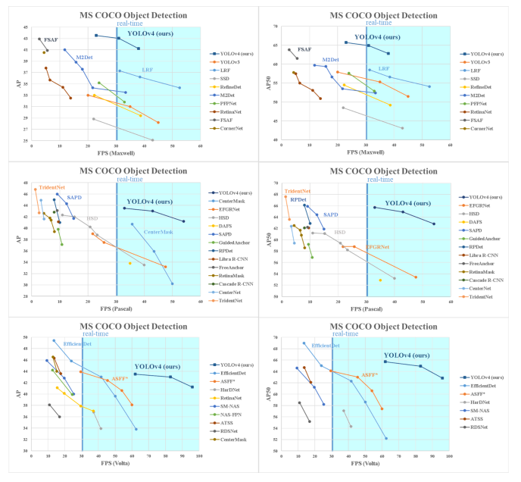
Experiments and Results.
On COCO dataset.
Comparison of the speed and accuracy of different object detectors.
On 3 different GPUs Maxwell/Pascal/Volta.
43.5% AP (65.7%AP50) for MS COCO at real time speed of 65 FPS.

Slide 34

Thank you

